Slide 1
Using Reinforcement Learning to Beat my Children (at board games)
Notes:
Bring cards along to the presentation
ANN vs NEAT don’t need to differentiate
Can’t know what’s in a digital twin
Move the so what earlier
Cut down jack and jill version on how can it be applied to other things.
Would be good to have "an ending" - not the lessons bits more did you do what you set out to do - did the ai win - can I see it etc etc great technically though - Jordans right maybe too much for beginners Thanks
BLUF.

Slide 2



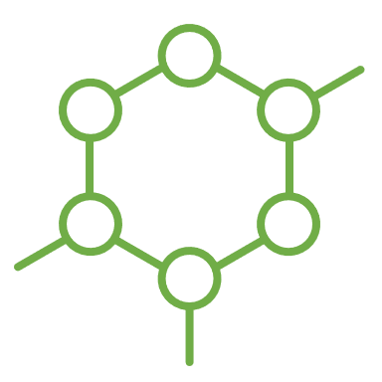
Contents
Outcomes
NEAT
So What?
Introduction
Dragonwood
Reinforcement Learning
2

Slide 3
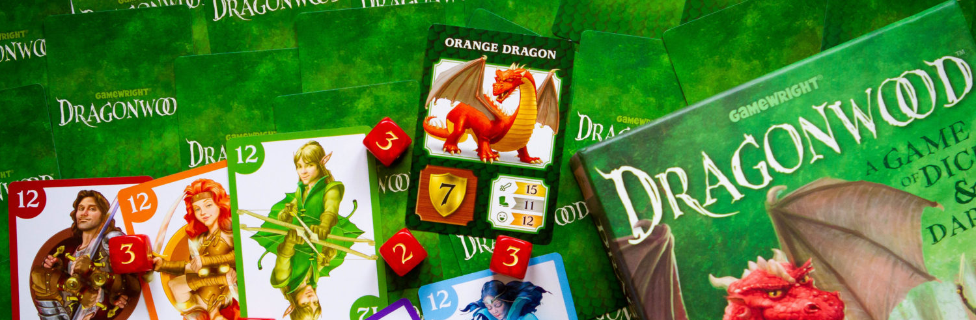
My Problem
Notes:
Kids like playing dragon wood
Increasingly getting better at it
I needed some help and strategies to beat my children
So I turned to Machine Learning

Slide 4
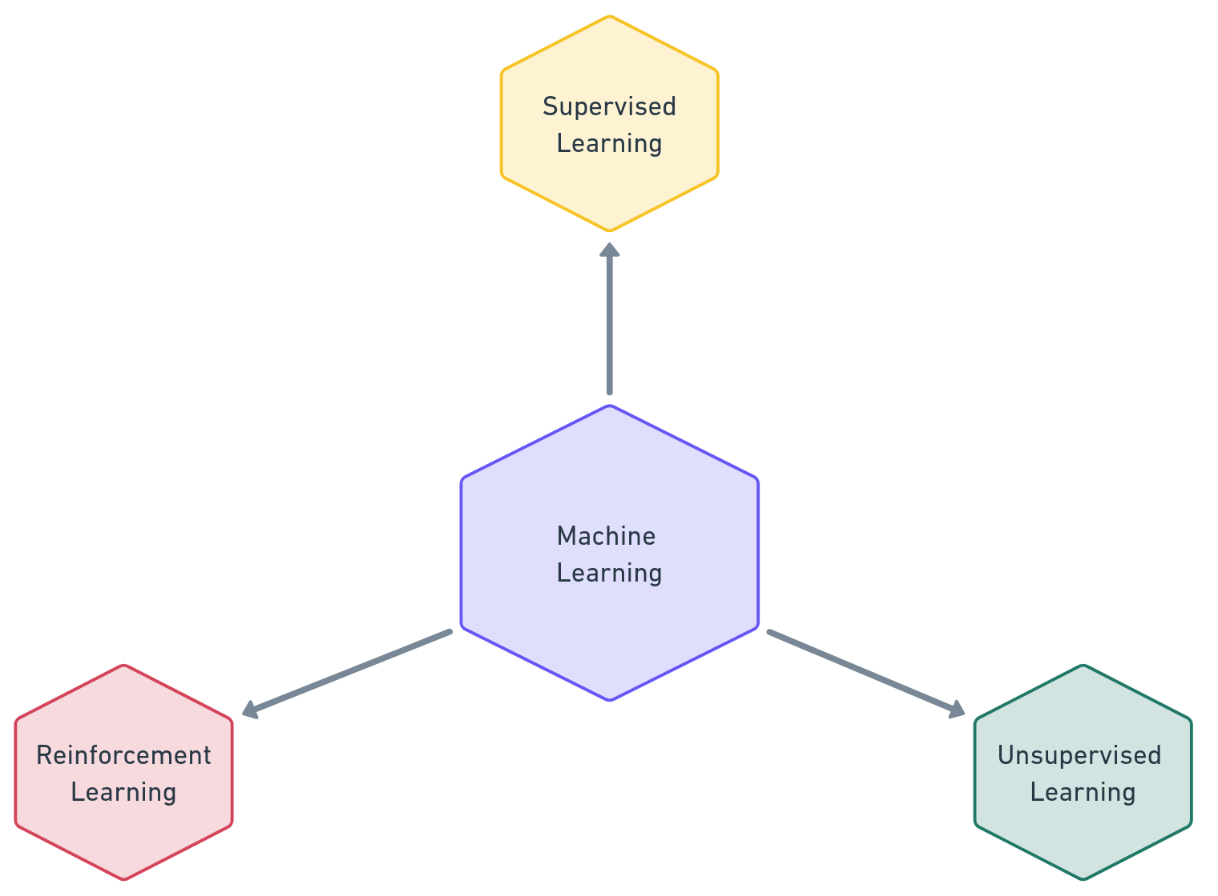
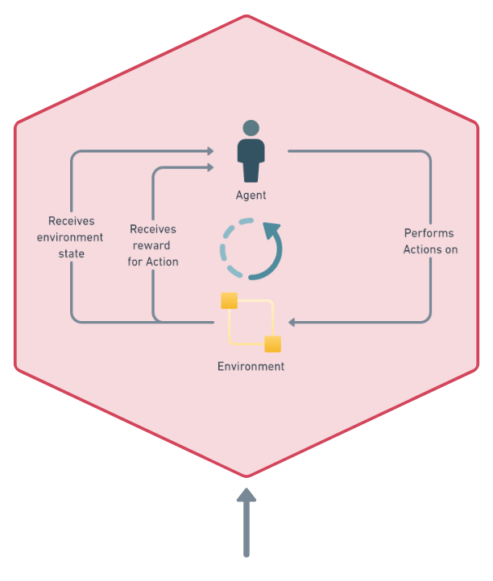
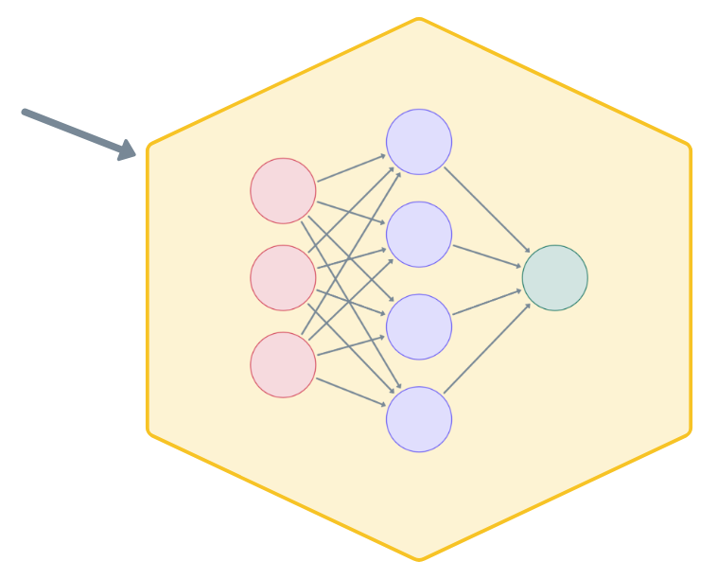
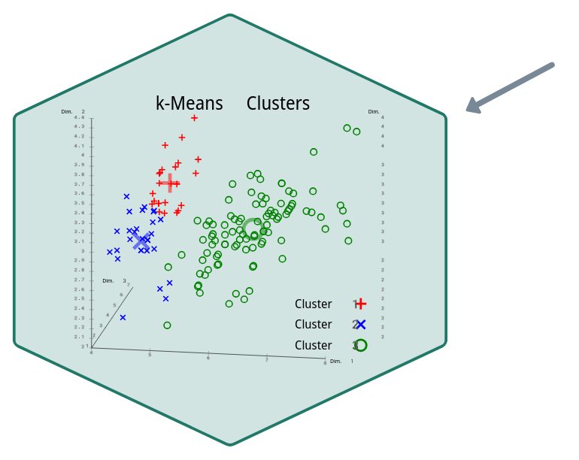
Machine Learning
Notes:
Machine Learning is an area within artificial intelligence that is concerned with predicting unseen data based on existing data using statistical methods.
Supervised learning:
data set that contains both the desired inputs and the desired outputs
For example,
linear regression,
logistic regressions
certain neural networks
Unsupervised Learning
patterns in unlabelled data.
Examples of this are clustering algorithms that look for groups within a dataset for examples k-means clustering and
Anomaly detection.
Reinforcement Learning is a framework for trying to solve a task within an environment.
We have an agent that performs actions to try and maximise a reward function. The agent is provided the state of the environment, it then decides on an action which is then applied to the environment and a reward is provided to the agent.

Slide 5
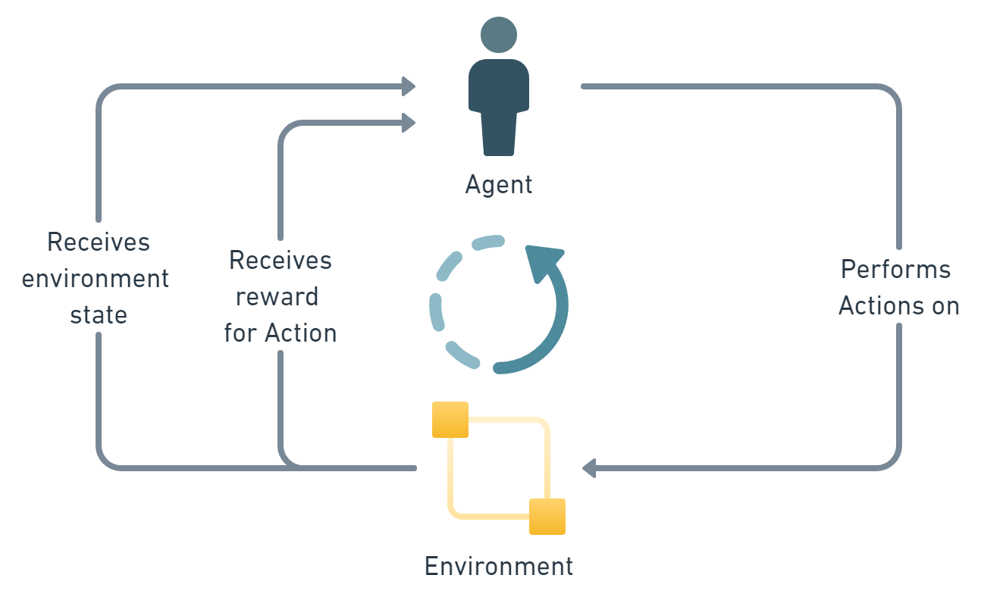
Intro to Reinforcement Learning
Notes:
Agent. An AI controlled user that can perform actions on the environment given a game state and receive a reward for those actions.
Environment. The environment is the entity we are a looking to learn from.
State. The state of the environment is a set of variables that describe the current game. This is something we have to devise and make sure it includes enough information for the AI to learn from.
Action. The action or decision that the AI has performed.
Reward. This is a function that provides a numerical measure on the suitability of the AI's action within the environment for the given state. This is for us to define and should reward the AI to prioritise beneficial behaviour. In our case we want to prioritise not only getting points but also winning the game.

Slide 6
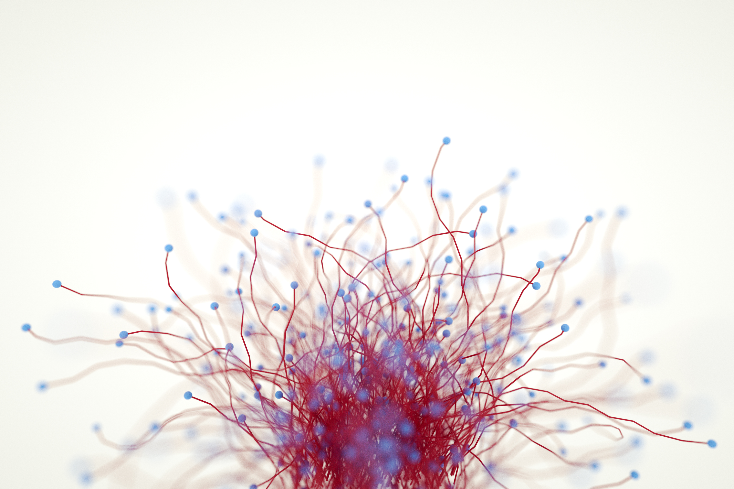
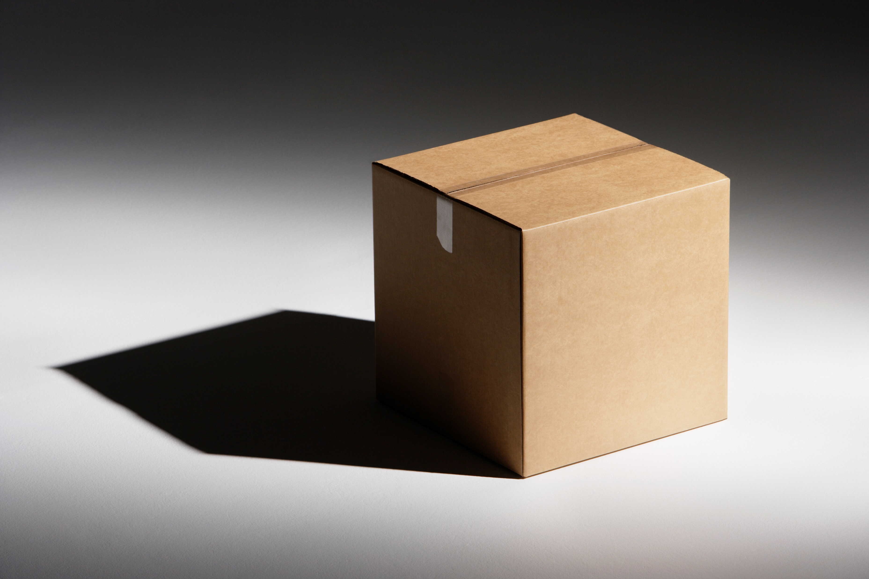
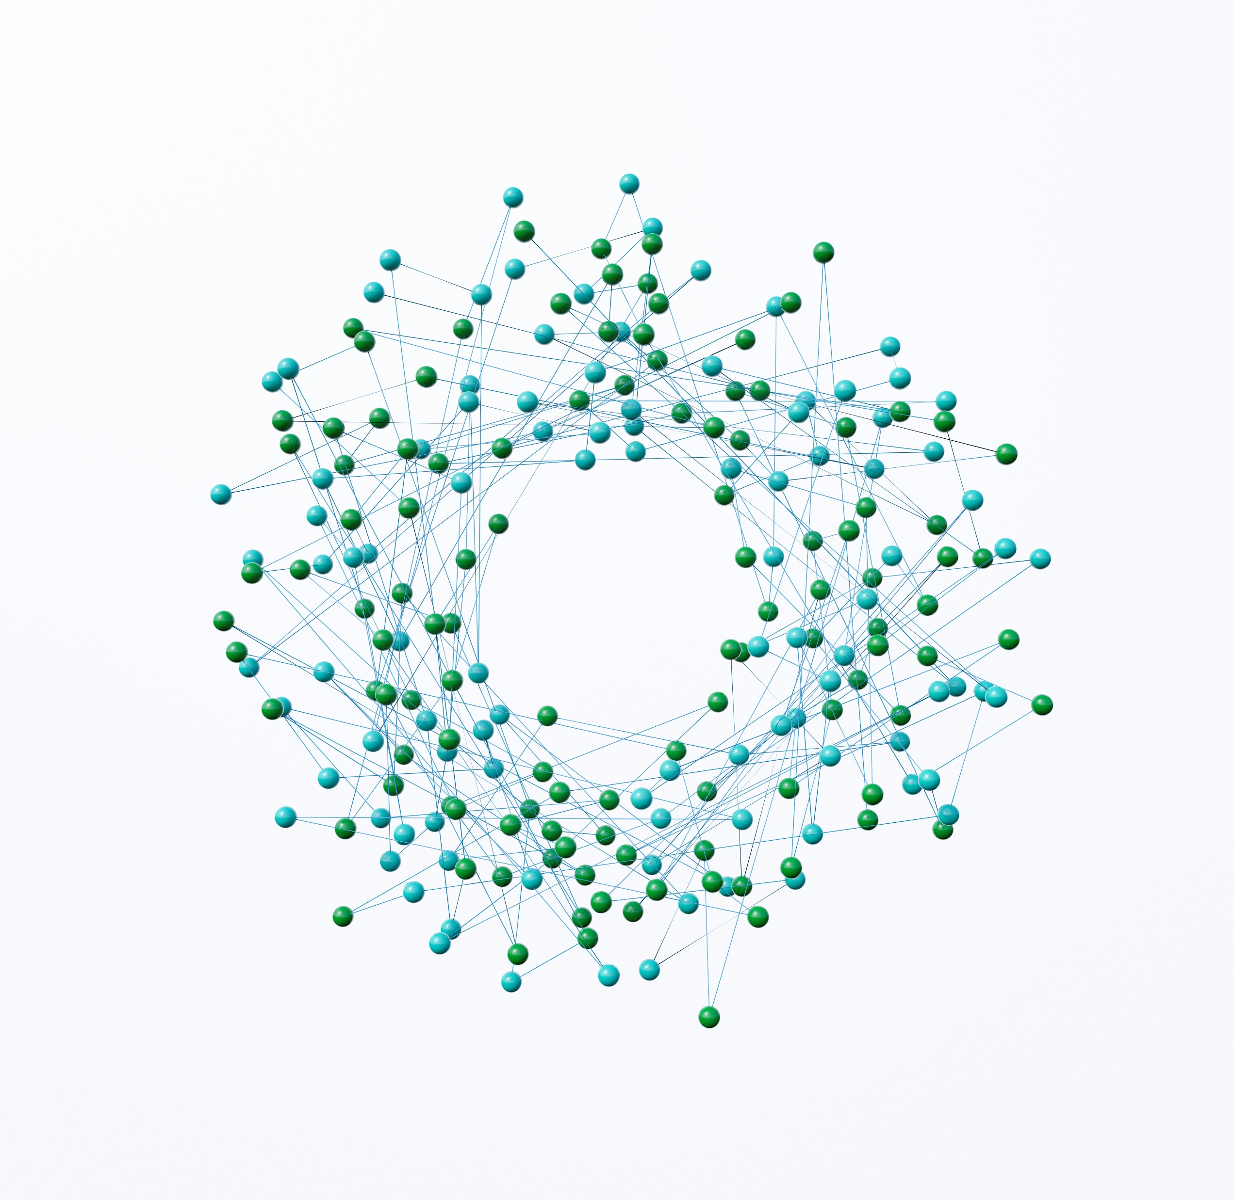
Reinforcement Learning in Action
Complexity
Black Box
Limited Resources
Notes:
Where the underlying system is too complex to optimise deterministically:
Supply chains
Maintenance Schedules
Where the system is a black box:
Digital twins
Parametric tools and Design for Cost
Where there are limited resources:
Demand planning
Scheduling

Slide 7
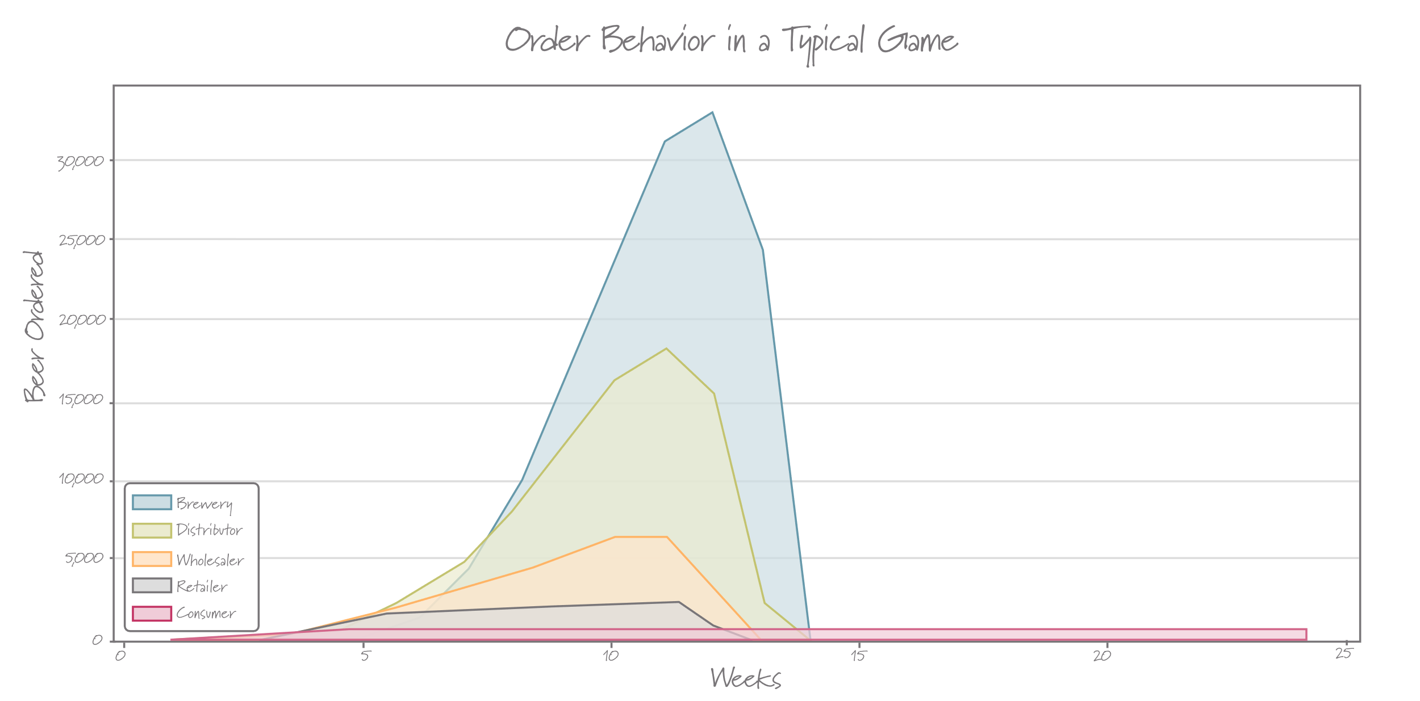
Reinforcement Learning in Action – The Beer Game

Slide 8
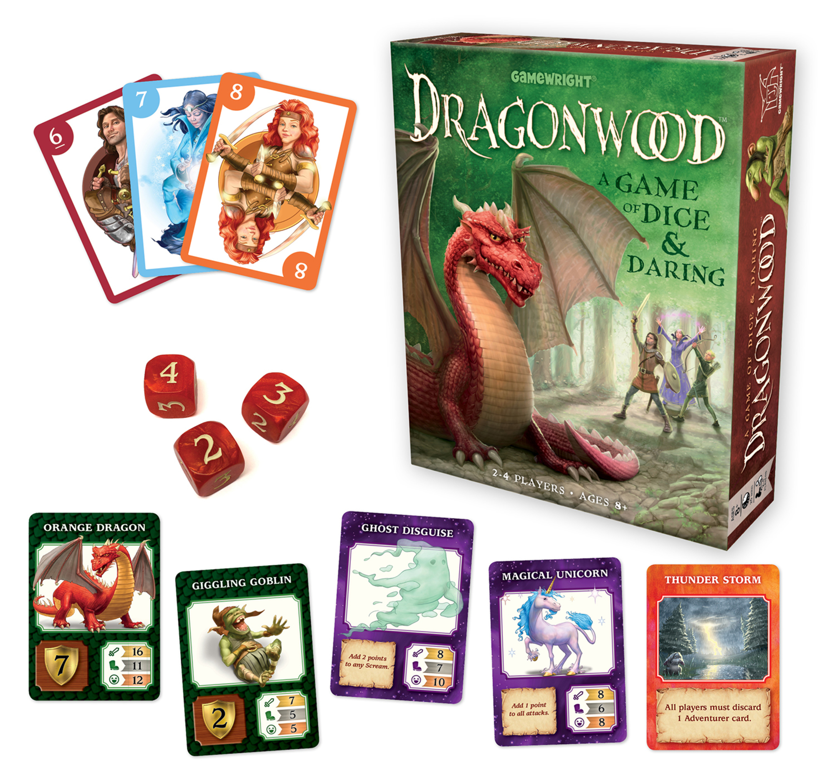
Intro to dragonwood
Card and Dice game for ages 8 up
Use cards in your hand to get dice with which to attack creatures to get points
Large random element
Strategy involved in when to attack and what cards to use.

Slide 9
Reinforcement Learning
Notes:
Things I need to do:
Develop the environment: Can I develop a series of classes in Python to replicate the game logic and rules?
Develop a reward function: How do I reward the agent for correct actions
Pick and algorithm and method to use
Develop a state representation, how do I encode the environment so that the agent can make decisions on actions and understand their impact.

Slide 10
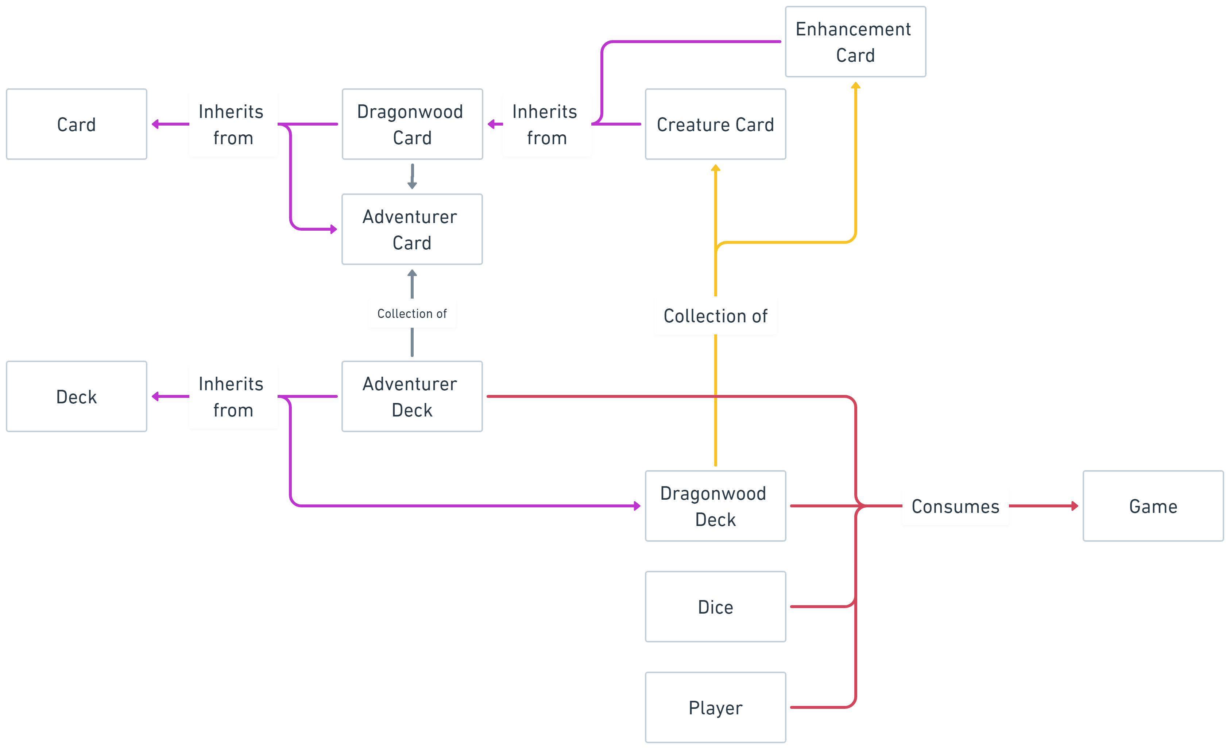
Python Model

Slide 11
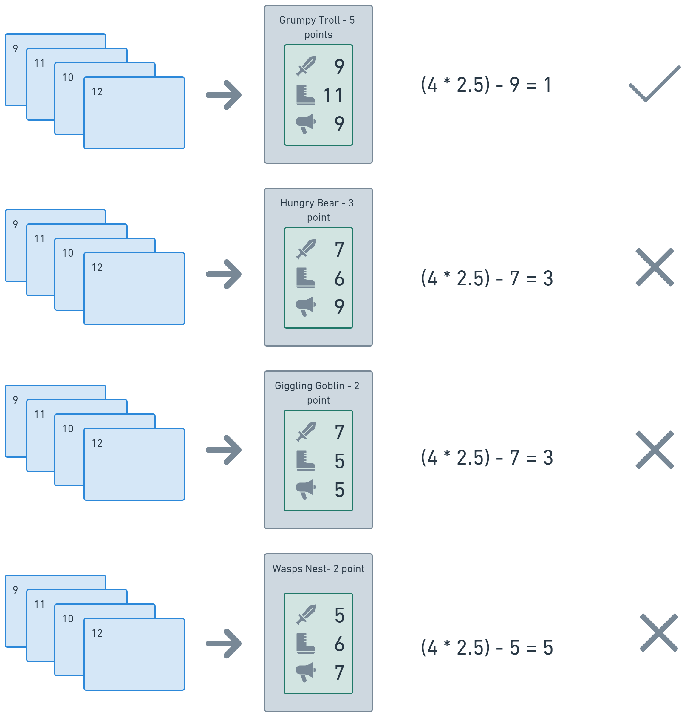
Deterministic Algorithm
Notes:
The Algorithm should:
Get as many points as possible
Using the fewest cards possible
In as few attacks as possible
Effectively looking to optimise the points per turn

Slide 12
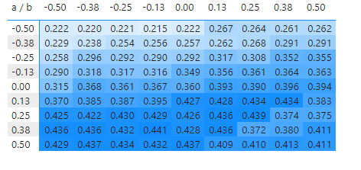
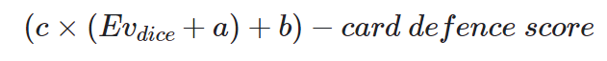
Deterministic Algorithm
Where:
𝑐 is the number of attacking cards
𝐸𝑣𝑑𝑖𝑐𝑒 is expected value of the dice.
𝑐𝑎𝑟𝑑 𝑑𝑒𝑓𝑒𝑛𝑐𝑒 𝑠𝑐𝑜𝑟𝑒 is the Dragonwood card's score to beat for that attack type.
Notes:
Trying to optimise the formula to the right.
The chart to the left shows the number of points per turn for various combined values of a and b.
Using a method called Grid Search to find best value.

Slide 13
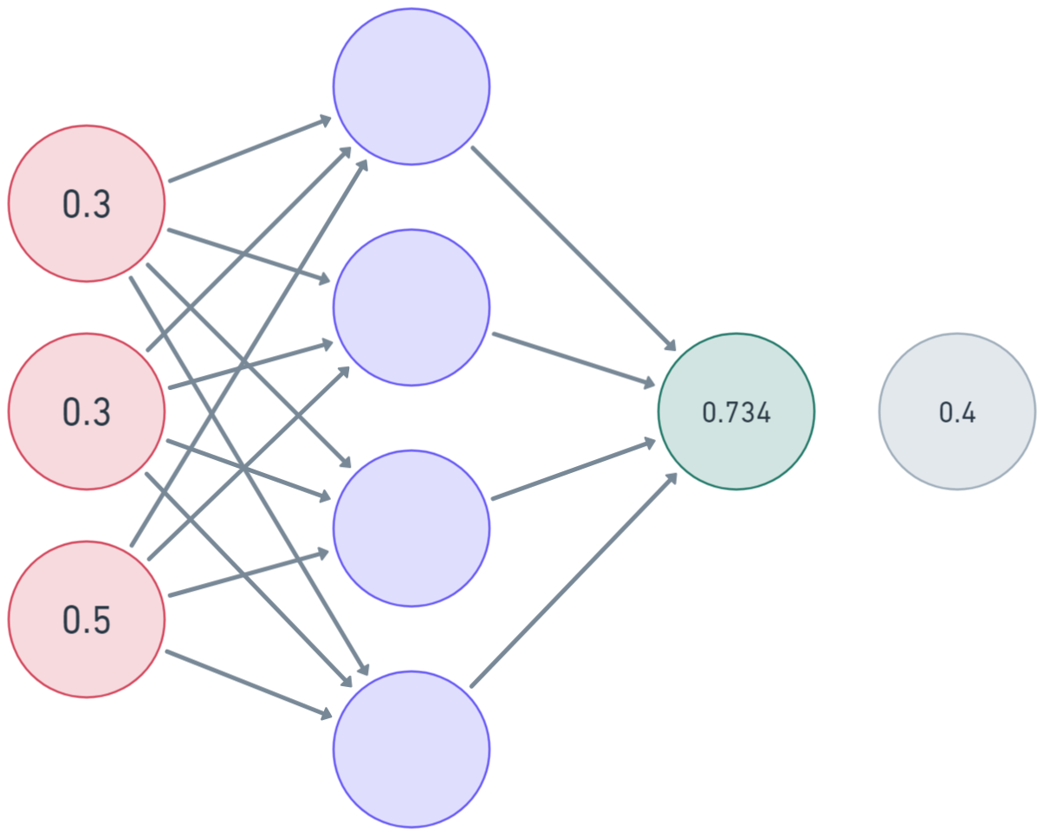
Develop an AI – Artificial Neural Networks
Notes:
method in artificial intelligence
is inspired by the human brain.
interconnected nodes or neurons in a layered structure that resembles the human brain.
It creates an adaptive system that computers use to learn from their mistakes and improve continuously.
Thus, artificial neural networks attempt to solve complicated problems, like summarizing documents or recognizing faces, with greater accuracy.

Slide 14
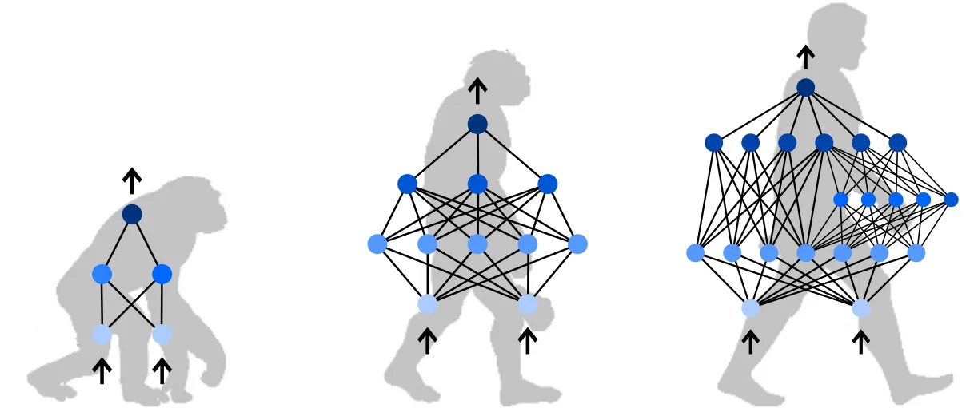
Develop an AI - Neuroevolution of Augmenting Topologies
Notes:
“Evolutionary” Algorithm used to generate Artificial Neural Networks to solve problems
Varies weights, biases and structure of Neural Network to find best solution.
Neural Networks undergo reproduction, can mutate and have their Species and Genes tracked throughout the process
Develops structure over time from simple beginnings
Similar performance to “Gradient Descent” used in some Neural Networks but does not need labelled dataset
Fit’s well for our problem. People have used it to teach AI to play Monopoly

Slide 15
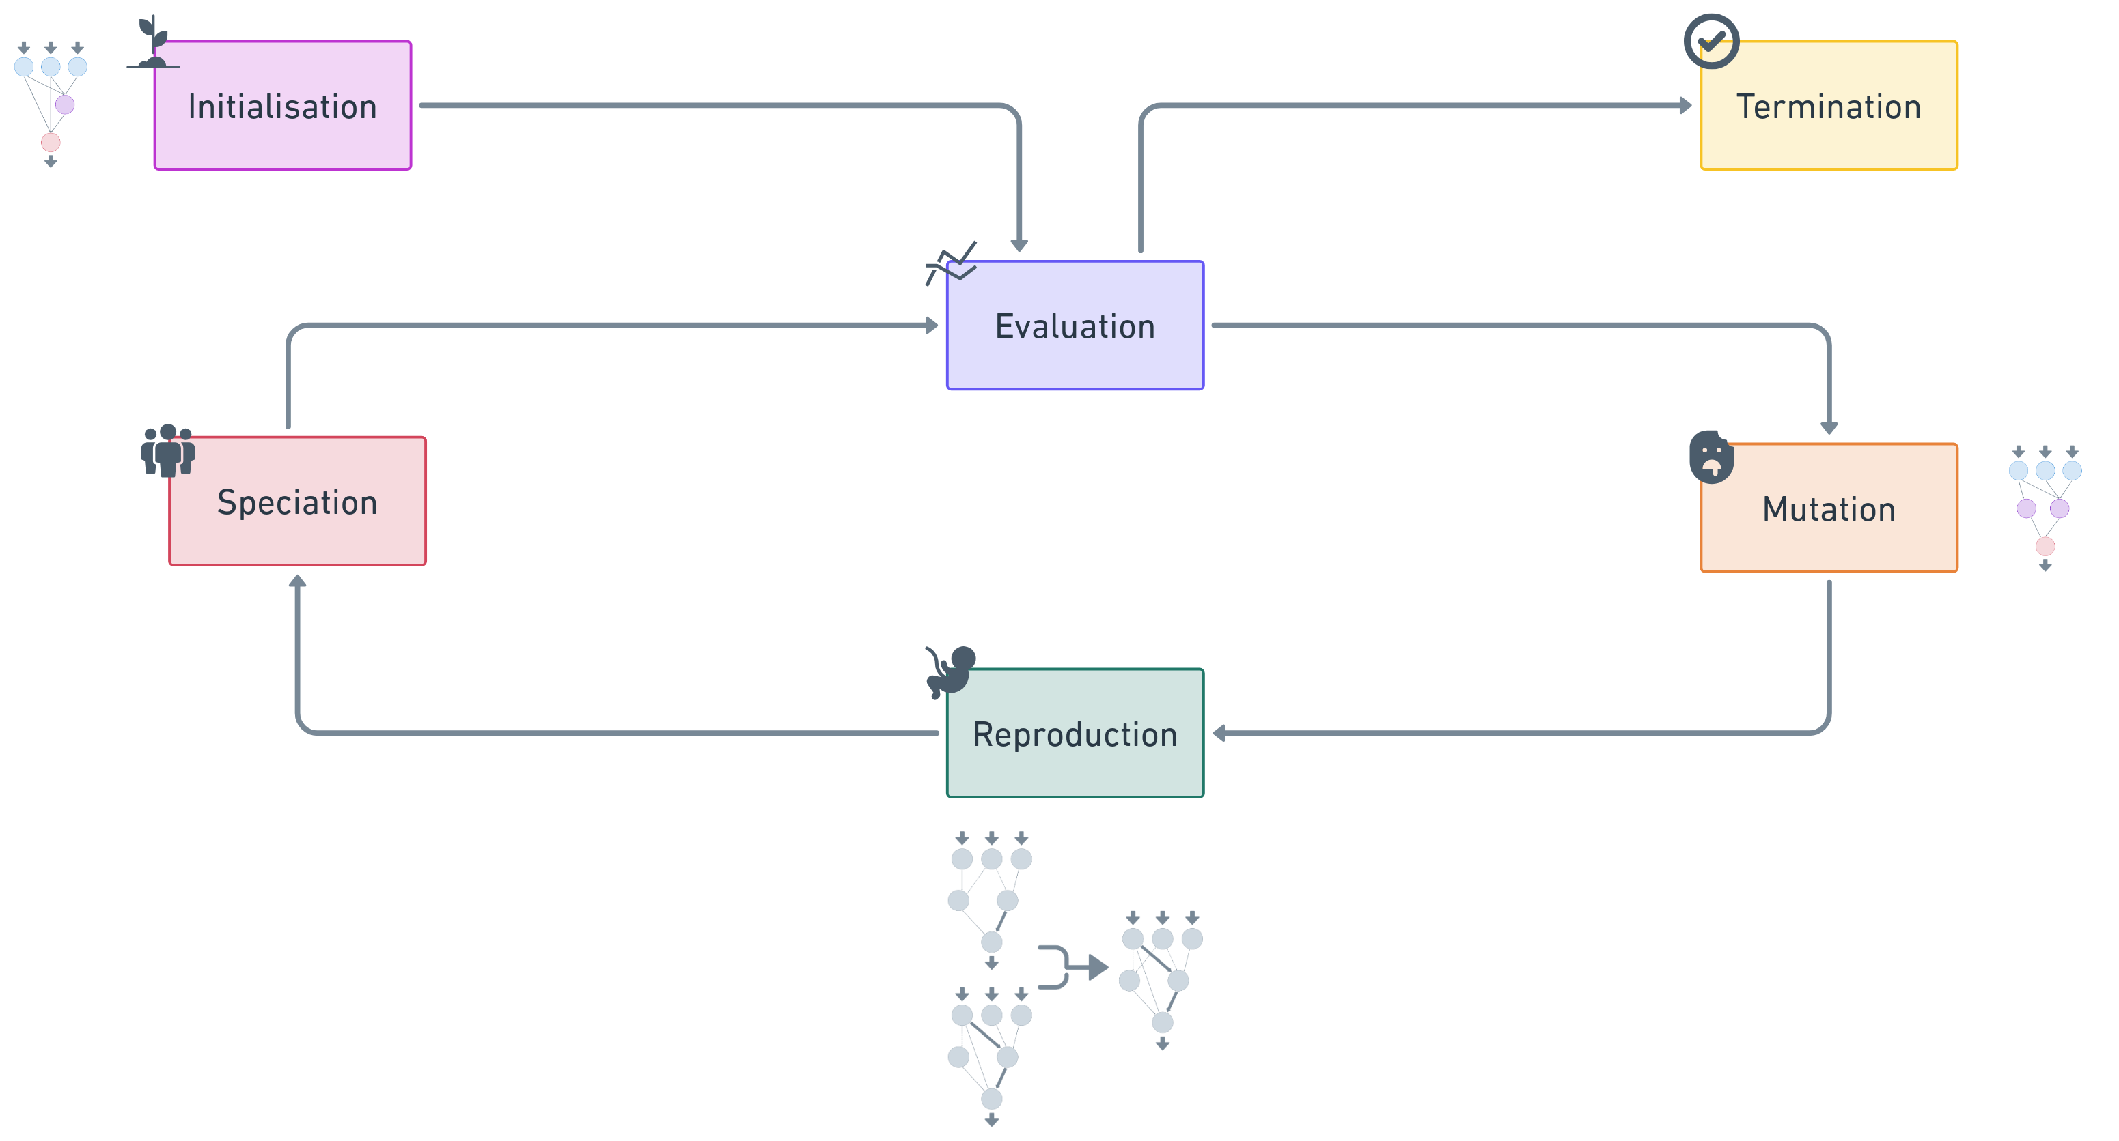
NEAT Process
Notes:
Initialisation:
Create simple neural networks based on parameters
No hidden layer, few connections
Evaluation & selection
Evaluate the network against a task
Fitness function defines success
Best performing networks are used
Stagnating networks are dropped
Mutation
Networks are varies by adding connections
Vary weights
Reproduction
Best performing networks are combined
Speciation
Group similar networks together
Allows comparison of different structures
Termination
Once a number of iterations (or generations) has happened
Fitness score reaches a predefined number

Slide 16
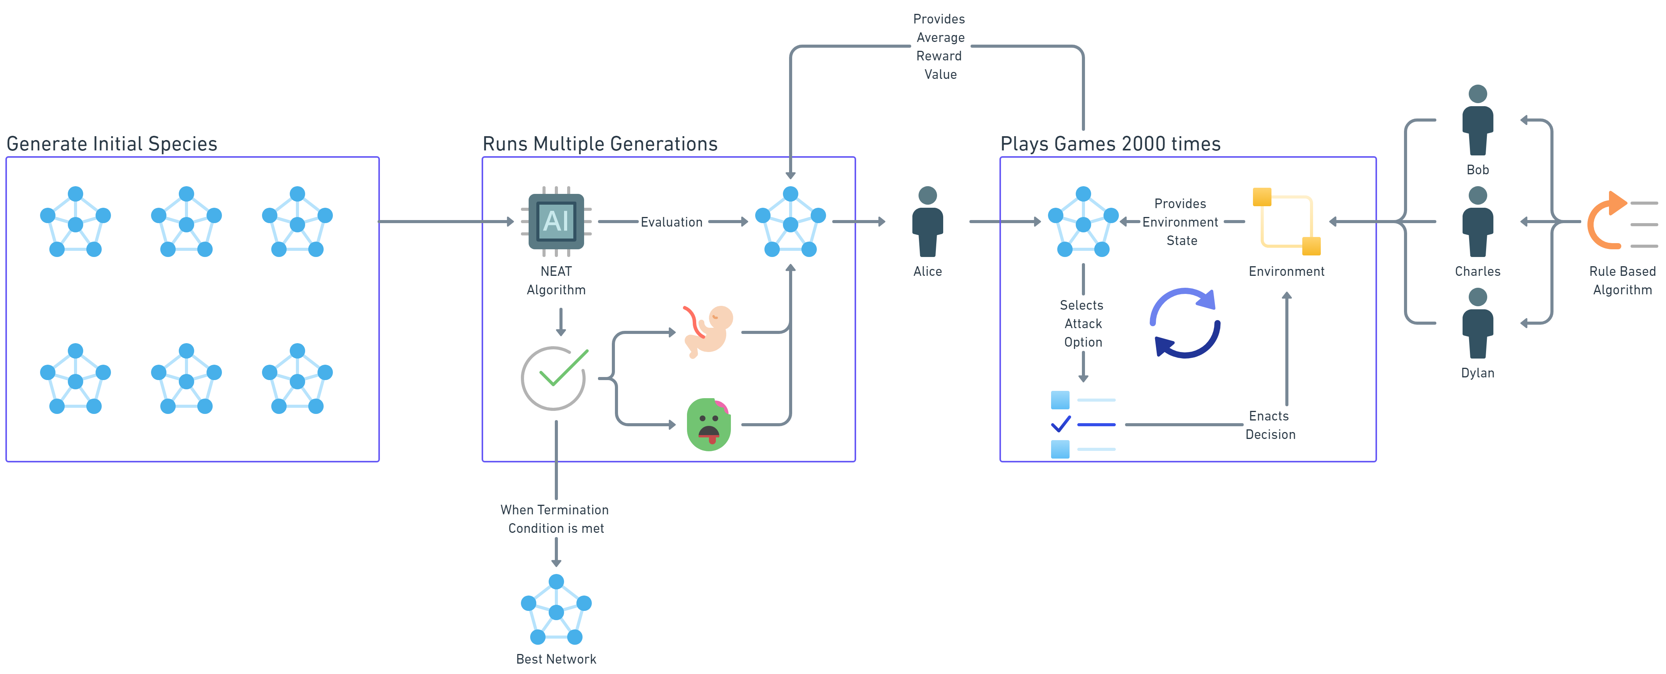
NEAT Process

Slide 17
Implementing NEAT
Notes:
Next I need to decide state function and reward function

Slide 18
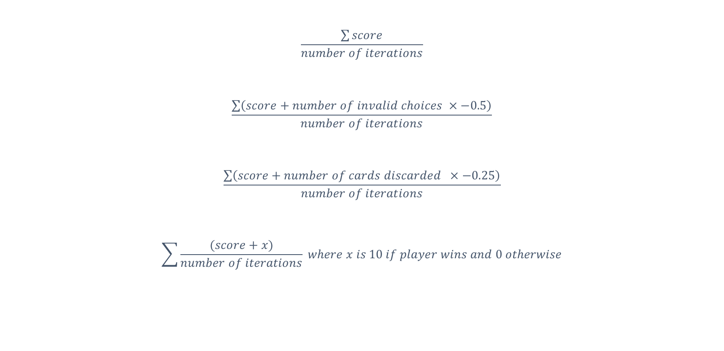
Fitness Function
$$\frac{\sum{score}}{number of iterations}$$
$$\frac{\sum{\left(score+number of invalid choices ×−0.5\right)}}{number of iterations}$$
$$\frac{\sum{\left(score+number of cards discarded ×−0.25\right)}}{number of iterations}$$
$$\sum{\frac{(score+x)}{number of iterations} where x is 10 if player wins and 0 otherwise}$$
Notes:
Like our deterministic algorithm we are trying to optimise:
The most points for the least amount of cards.
First did too many invalid choices
Second discarded too may cards
Third did nothing
Eventually we

Slide 19
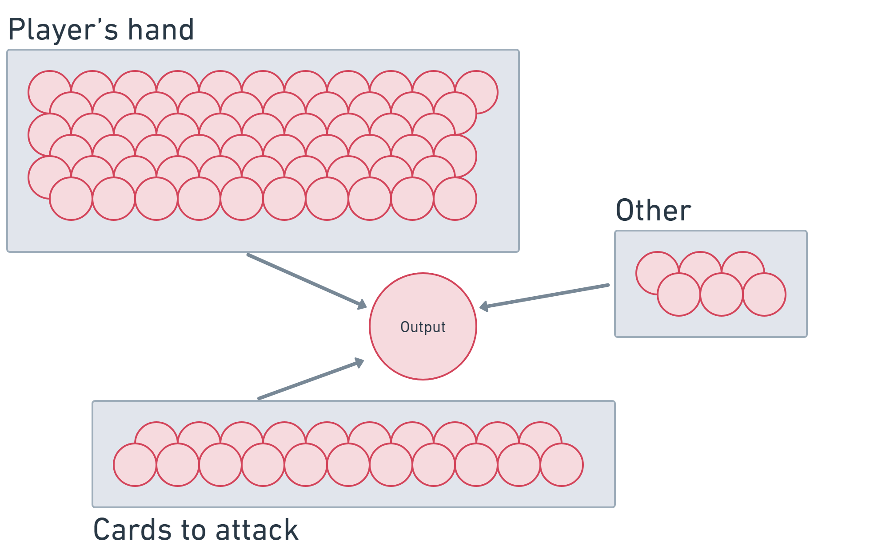
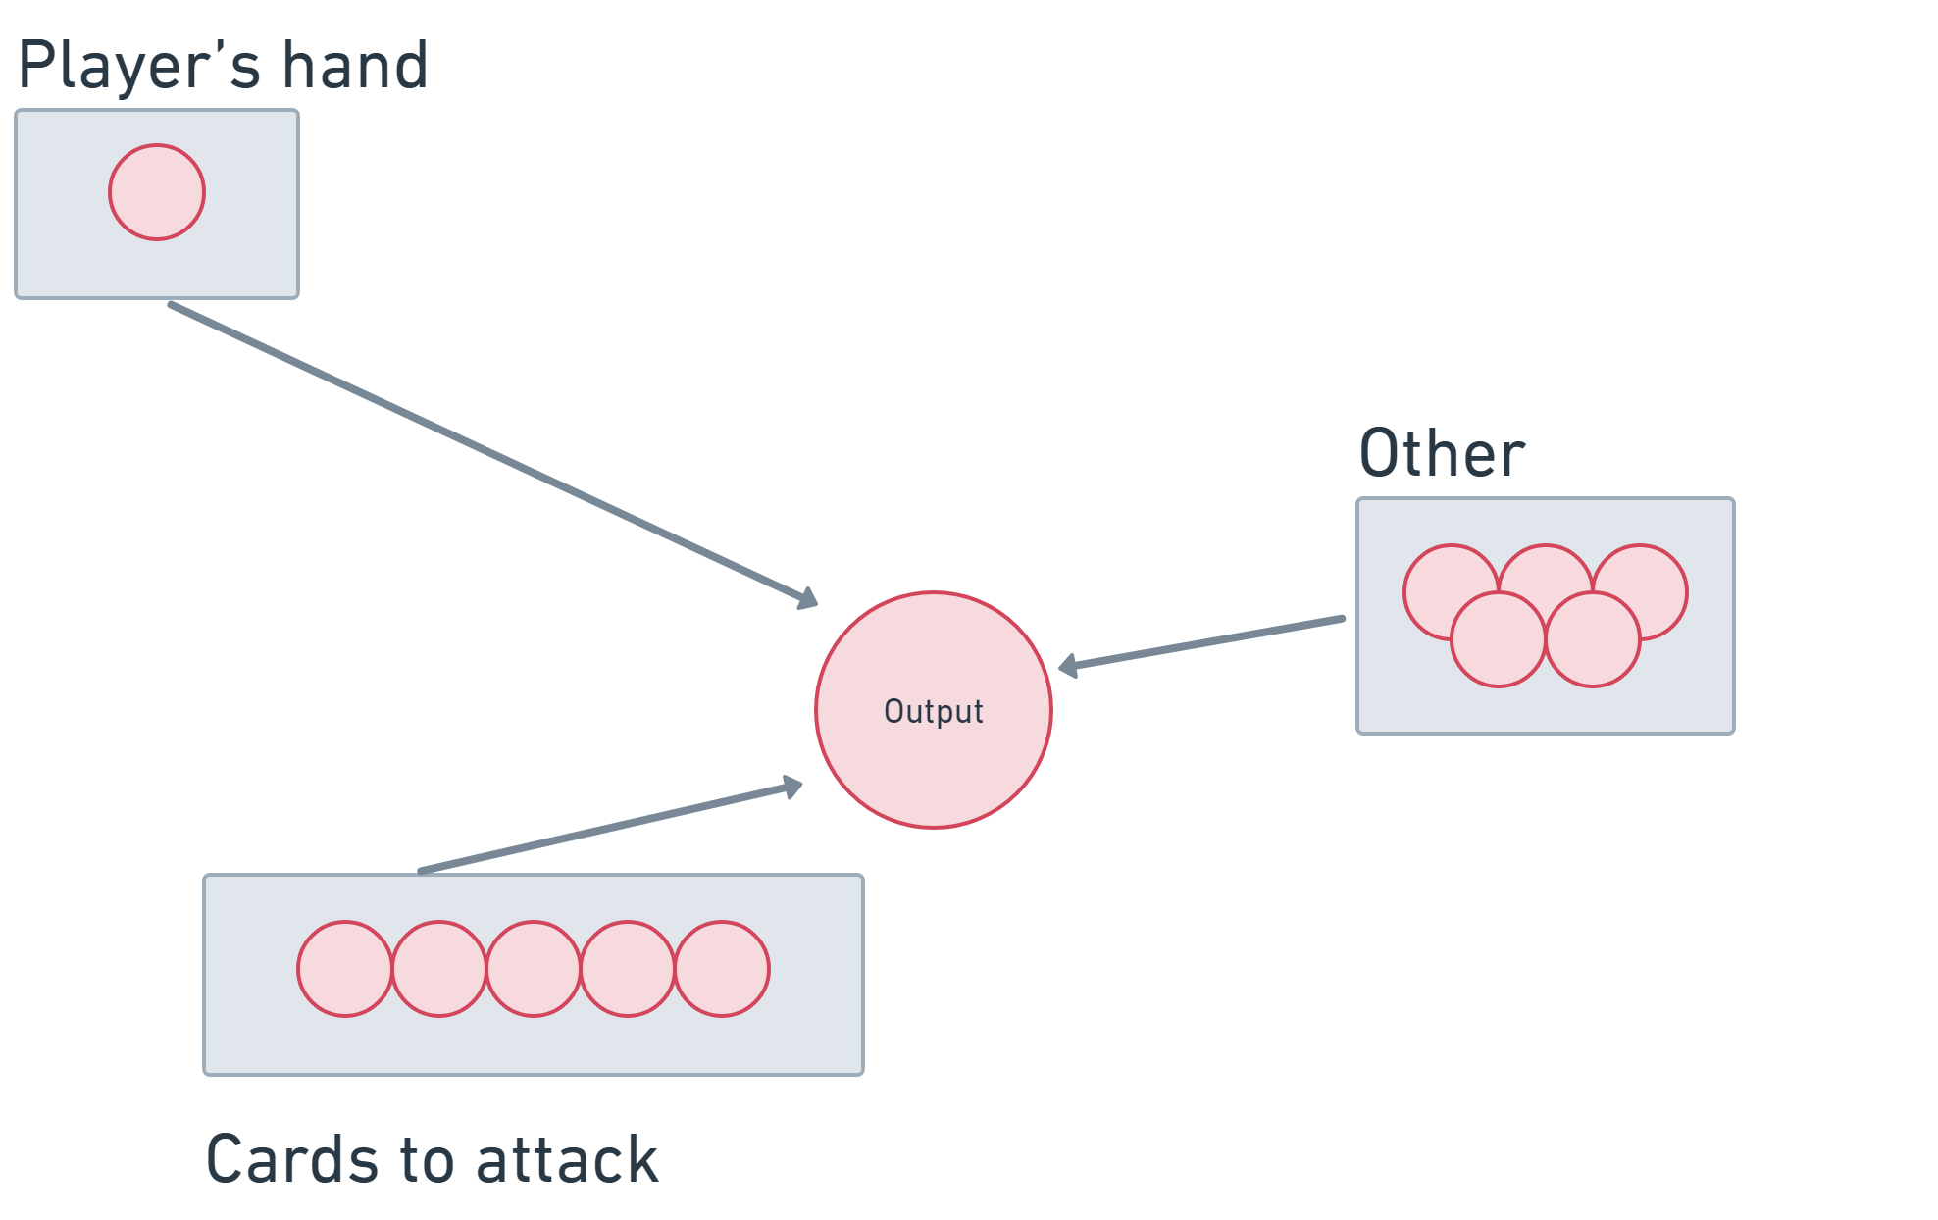
Input Encoding
First iteration – 79 Neurons
Second iteration – 11 Neurons
Notes:
Complexity of the input encoding

Slide 20
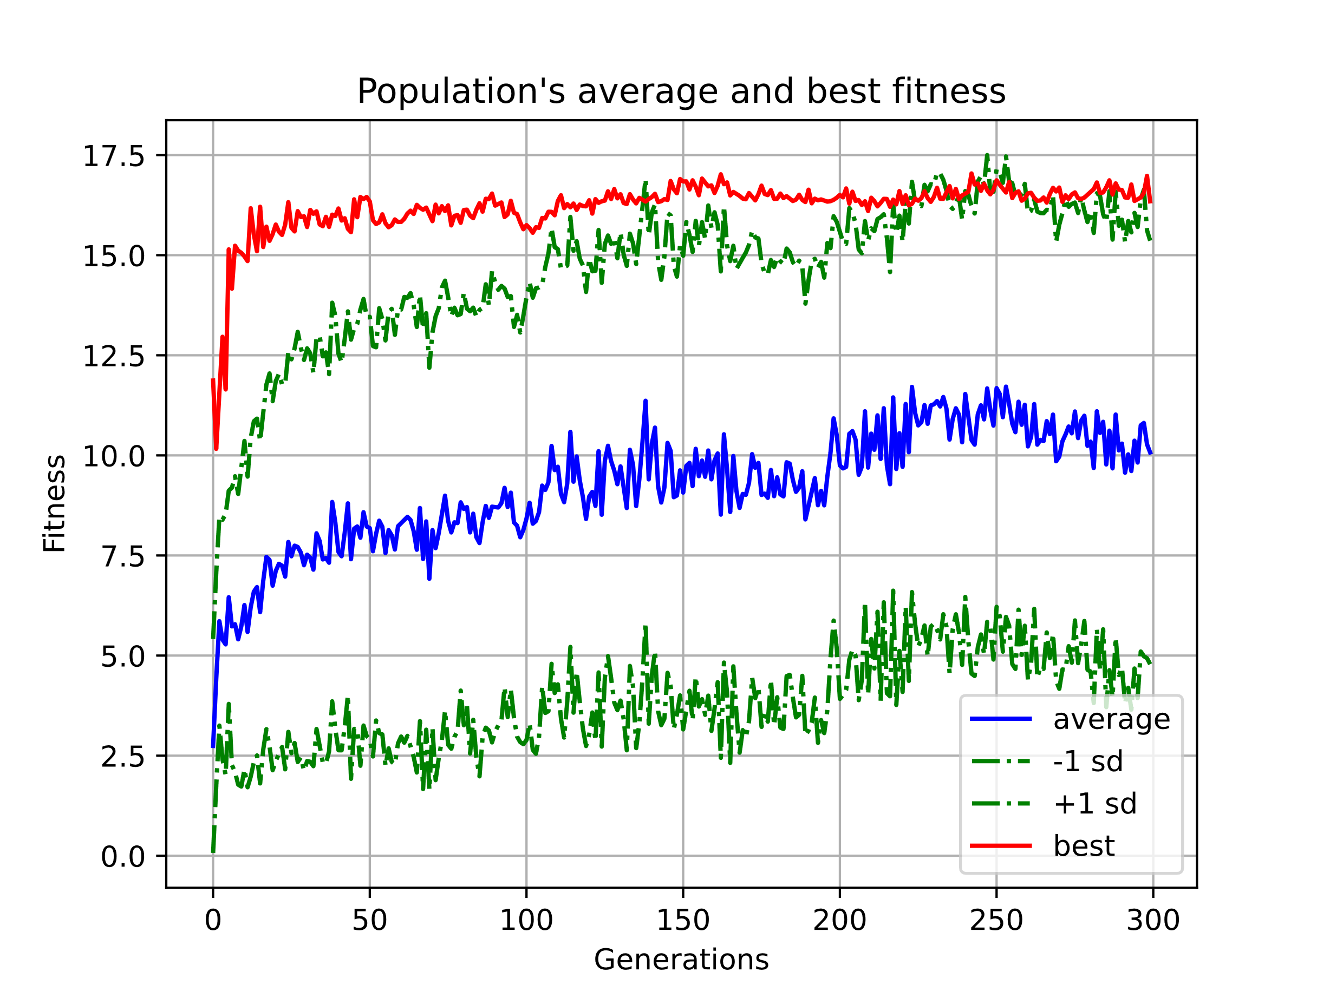
SUCCESS
Notes:
Over time we can see the average score obtained by the algorithm increase until we stopped it at 30 generations.
300 generations with 150 members with 2000 games over generation = 90,000,000 games played.

Slide 21
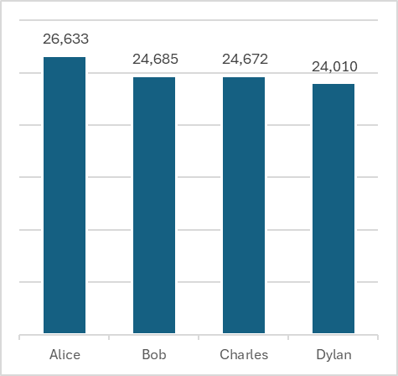
SUCCESS – impact of new algorithm
Notes:
7% improvement on Rule based algorithm
When the AI trained player plays against the deterministic players. It will win 7% more times than the other players.
It seems the network had found a more efficient version of my initial deterministic formula.

Slide 22
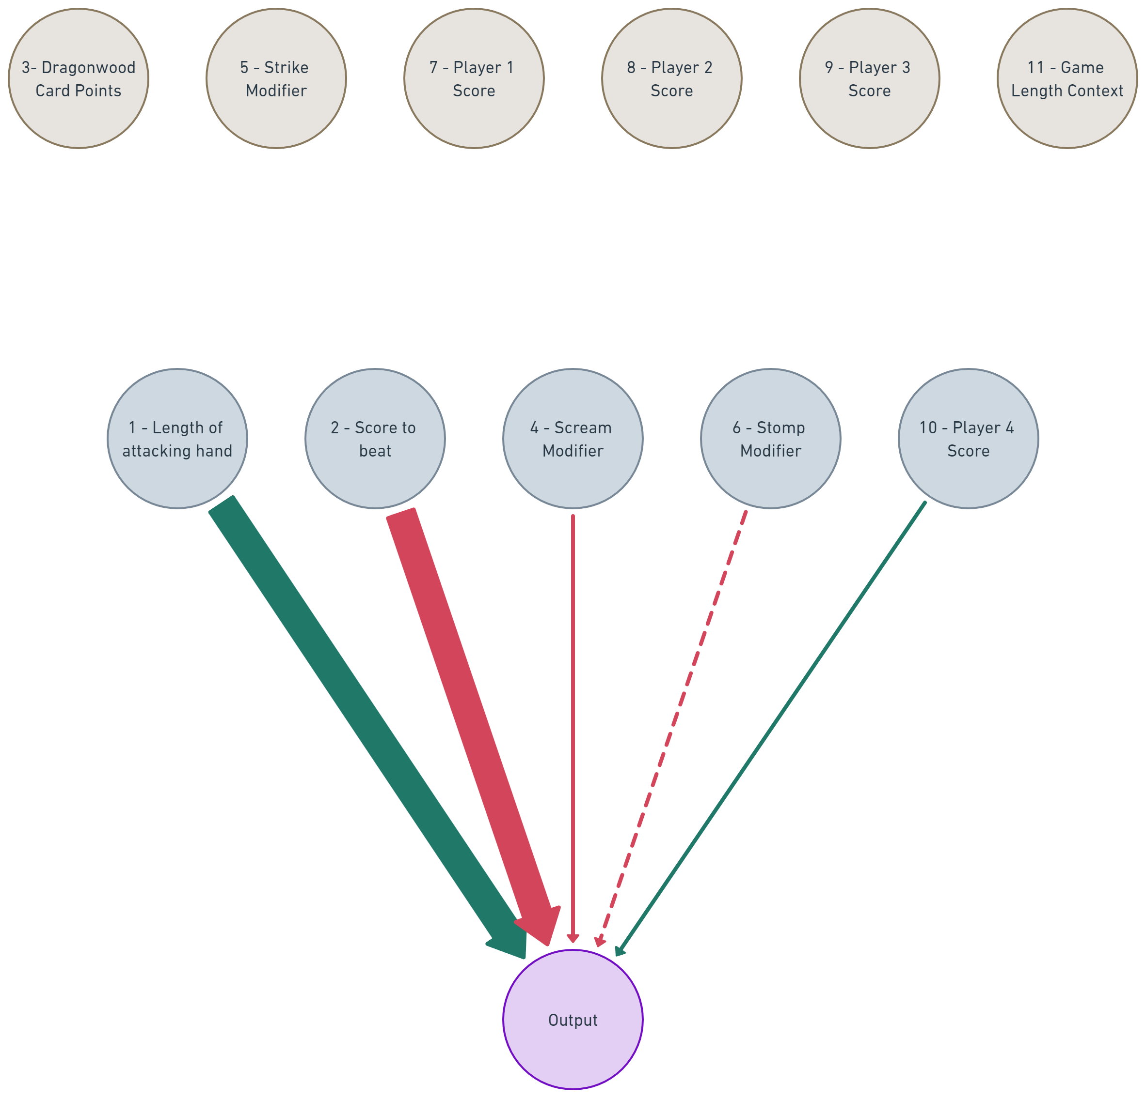
Final Network
Notes:
It’s interesting that only 2 input nodes are having a large impact on the output.
Structure of Neural Network has remained simple probably down to simplistic assumptions I have made.
The actual points gained from the card is not important.
Probably a result of a well balanced game.

Slide 23
Lessons Learnt
The three lessons I have learnt from the process are:
Be very careful when generating the input encoding.
Sometimes a rule-based approach will give good enough results.
Be quicker as children get bored easily.

Slide 24





WhiteTRee
Whitetree are a multi-disciplinary consultancy providing transformational services primarily into the Defence and Aerospace sectors. We specialise in:
Decision Support
Business Winning
Management Services
Training Solutions
Support Engineering​
Solutions Engineering
Talent Acquisition
Our consultants have extensive experience in their specialist domains.

